Slide 1
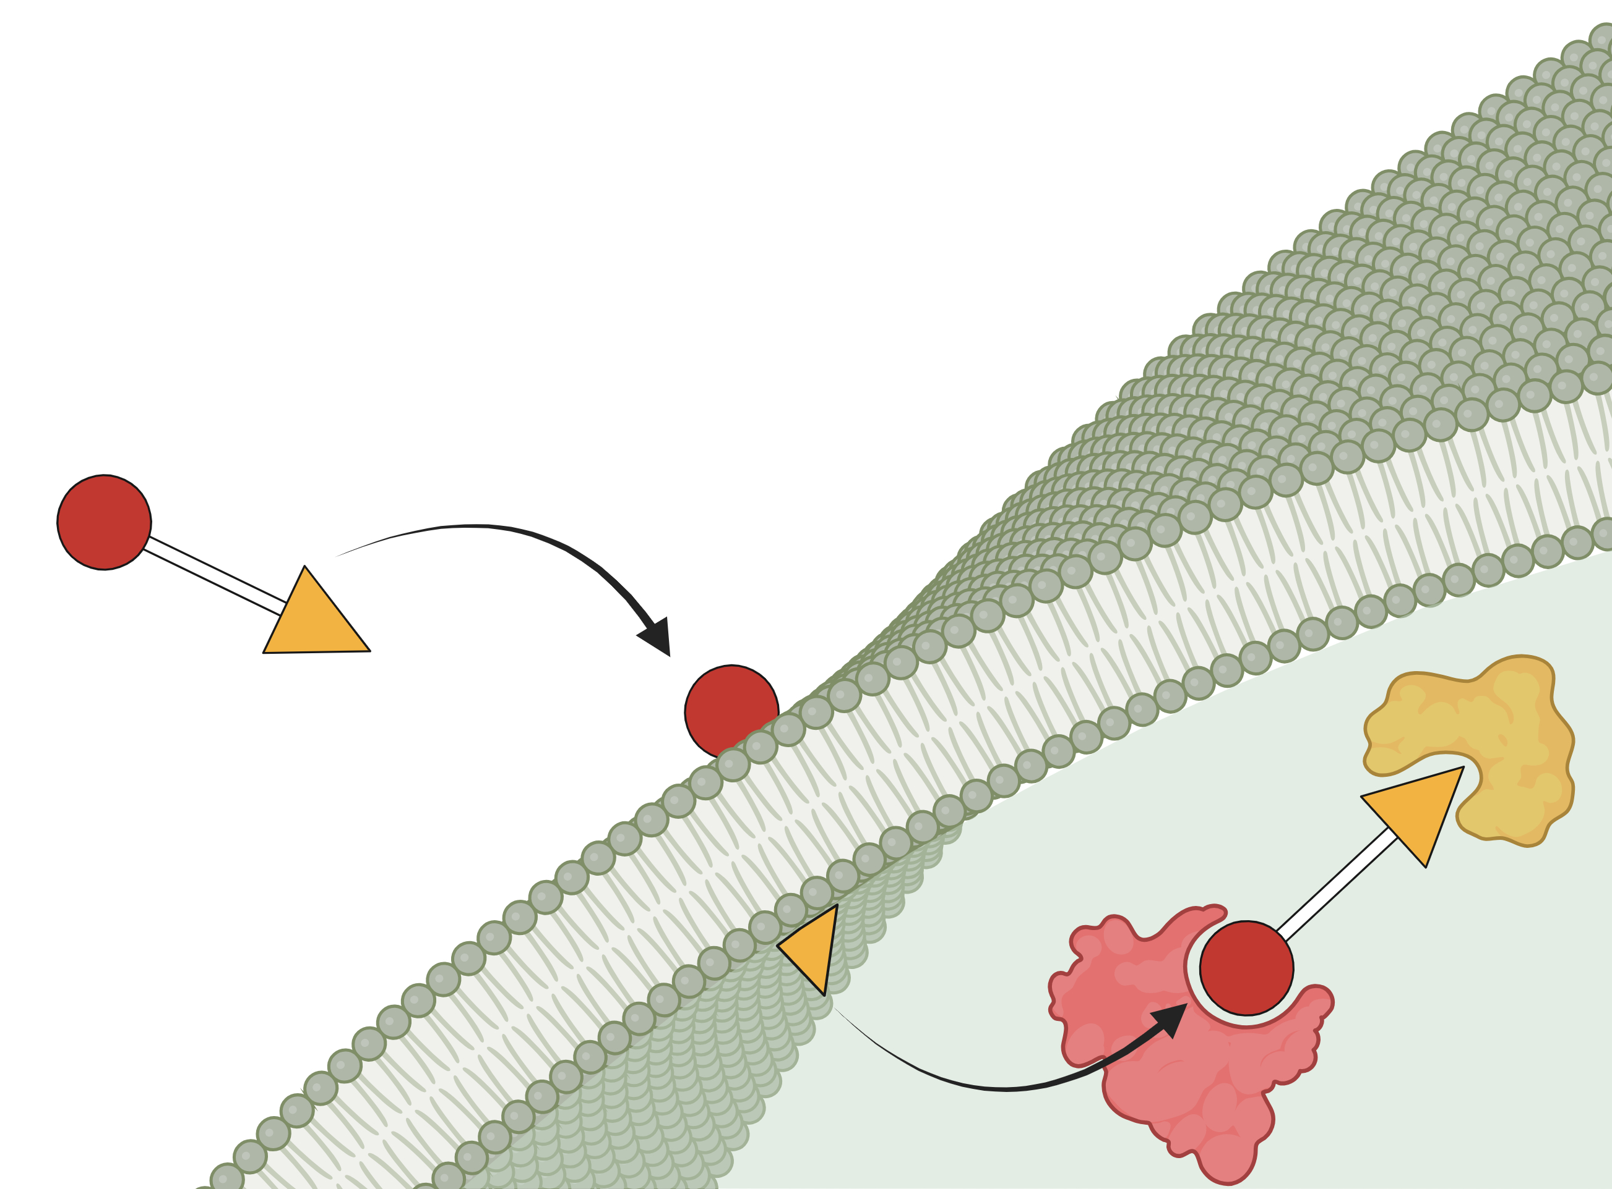
Designing PROTACs for
Intracellular Exposure: the role of permeability and physicochemical properties
Emma Inganäs, PhD
PhysChem Forum 13-14th October 2026, Antwerp

Slide 2
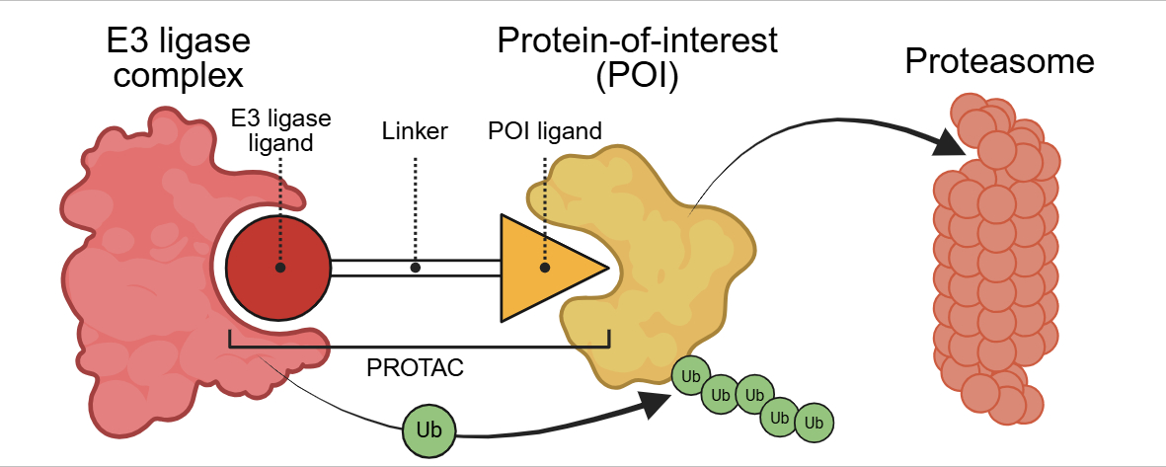
Why intracellular exposure matters for PROTACs
Background

Slide 3
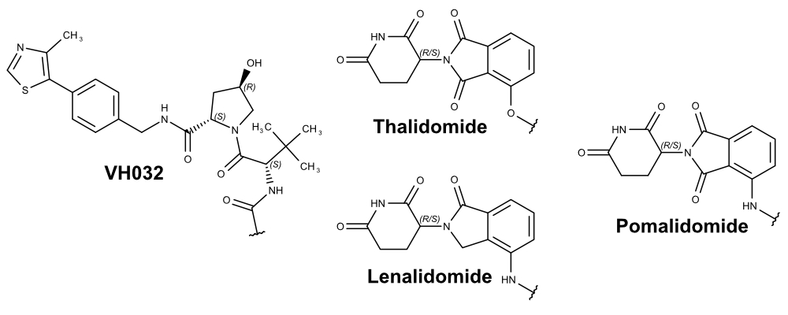
Why intracellular exposure matters for PROTACs
Background

Slide 4
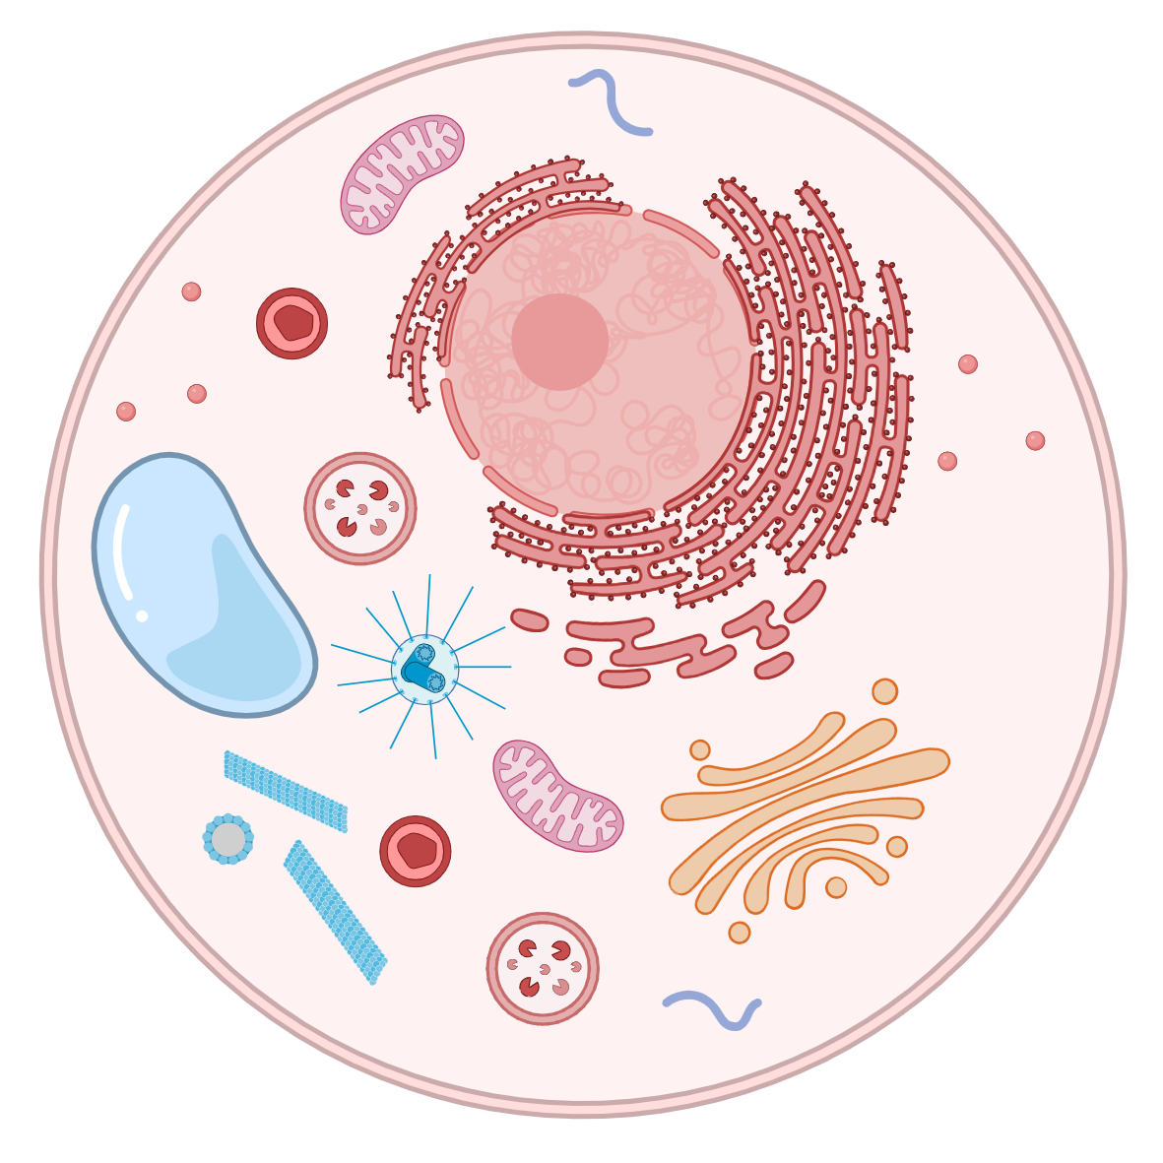
The challenge
Beyond Rule-of-5 chemical space & intracellular targets
Background
PROTAC DESIGN
Often lipophilic and large
Potentially chameleonic properties
What determines whether a PROTAC achieves sufficient intracellular exposure to engage a target?

Slide 5
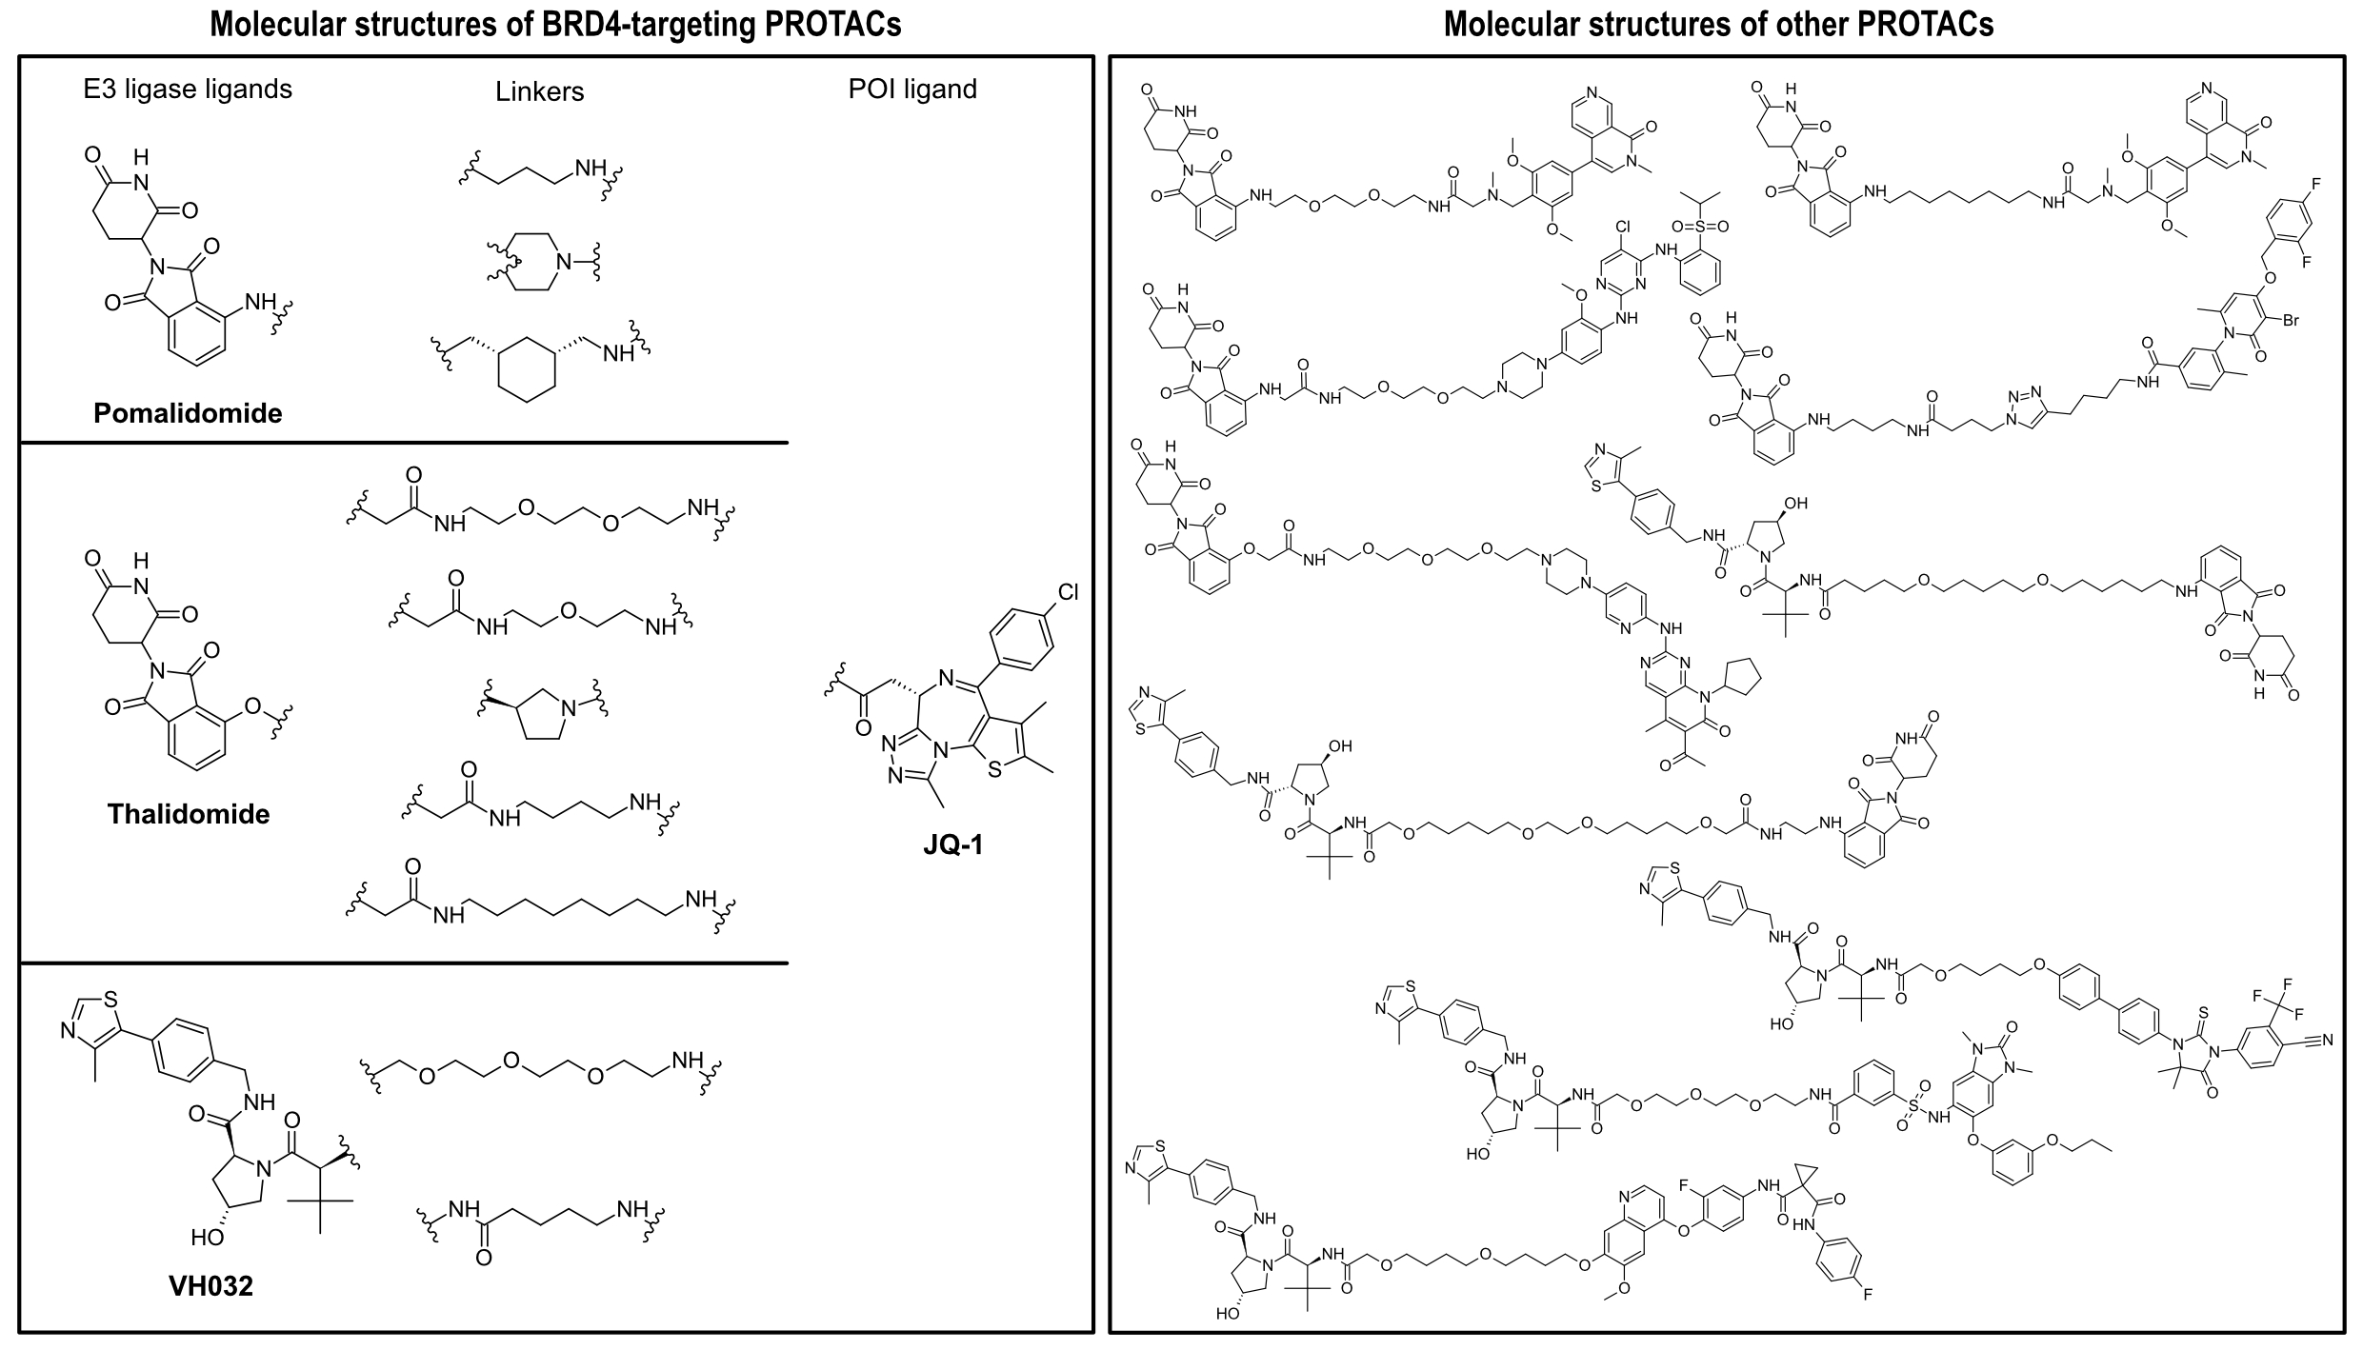
PROTACs investigated
PROTACs

Slide 6
Roadmap
Roadmap
NanoBRET IC₅₀
permeabilized cells
Target affinity
Membrane interactions
Passive permeability
Intracellular exposure
Target engagement
Simulation
Membrane affinity
Papp
Kp_{uu}
NanoBRET IC₅₀
live cells
What determines cellular target engagement?

Slide 7
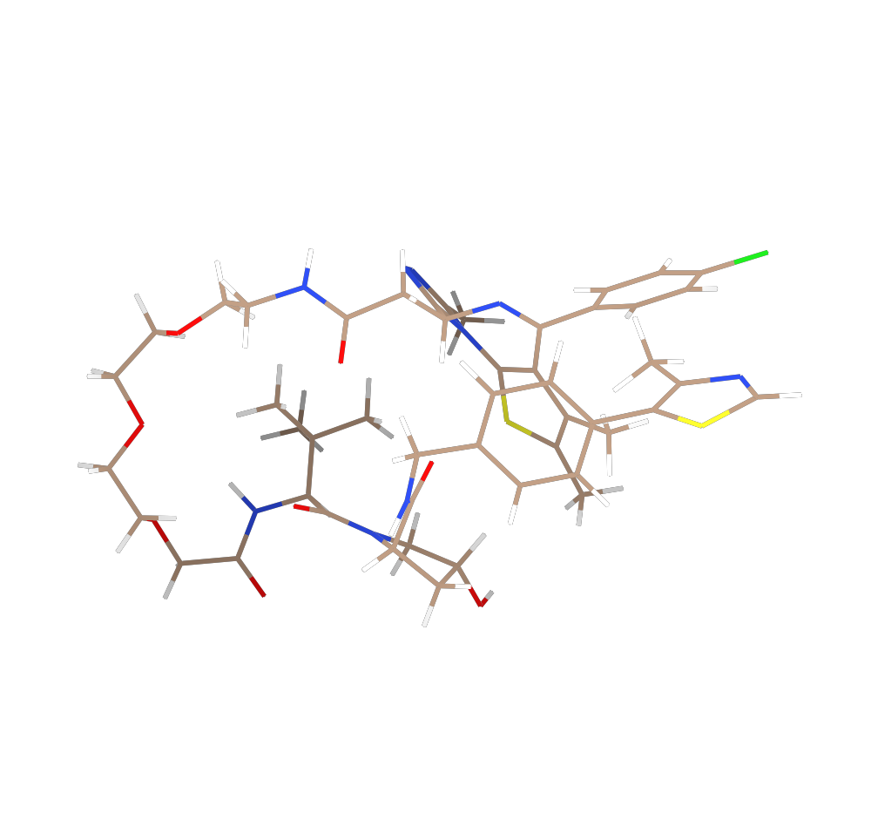
Roadmap
Roadmap
What determines PROTAC–membrane interactions?
Target affinity
Membrane interactions
Passive permeability
Intracellular exposure
Target engagement
Simulation
Membrane affinity
What determines cellular target engagement?
Notes:
What determines PROTAC–membrane interactions?

Slide 8
In silico calculations and simulations
Background
Generate physiologically
relevant conformations
Simulate membrane model

Slide 9
In silico calculations and simulations
Simulation of PROTAC-membrane interaction
Background
Free energy (kcal/mol)
Membrane normal (z)

Slide 10
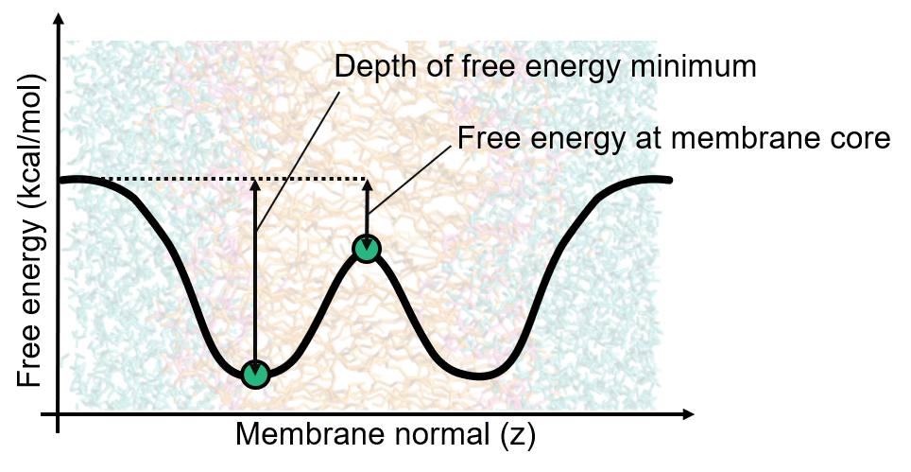
In silico calculations and simulations
Calculation of free energy barriers
Background

Slide 11
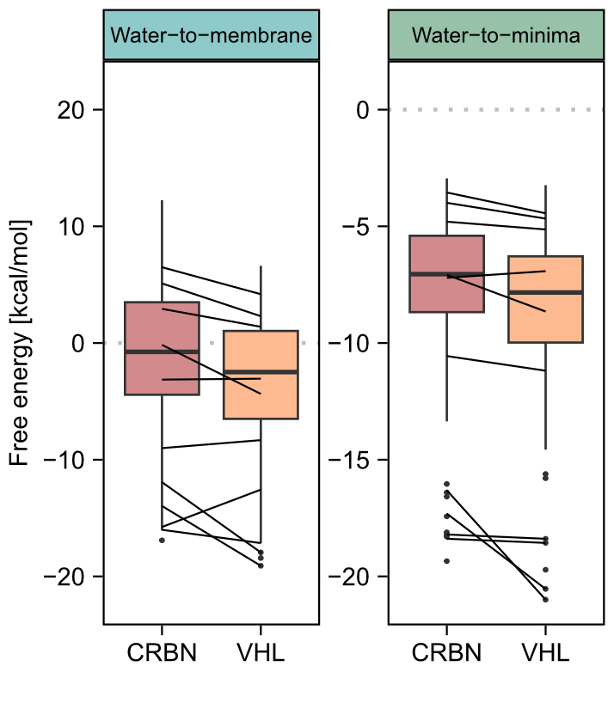

Results
E3 ligase choice influences membrane interactions
VHL-based PROTACs exhibit lower free energies than cereblon-binding PROTACs
Confirmed by structurally matched compounds
Inganäs, E. et al (2025). J Med Chem.

Slide 12
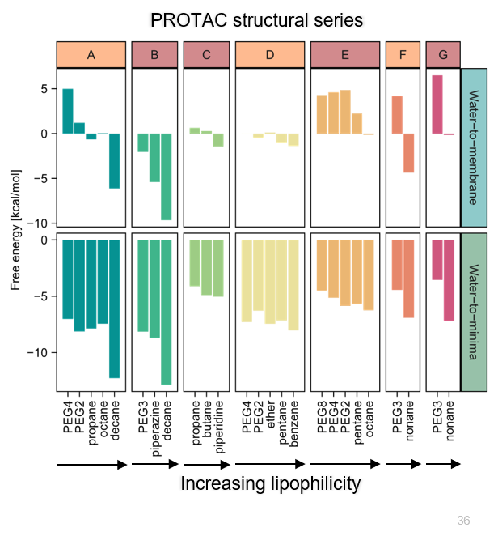
Linker design modulates membrane interactions
Results
Structurally matched series:
  Identical E3 ligase ligand and POI ligand
More lipophilic linkers led to lower free energies in the membrane
Inganäs, E. et al (2025). J Med Chem.

Slide 13
Structural modifications affect membrane energies
Results
Structural modifications affect membrane energies!
Do the simulations reflect experimentally observed membrane interactions?
Inganäs, E. et al (2025). J Med Chem.

Slide 14
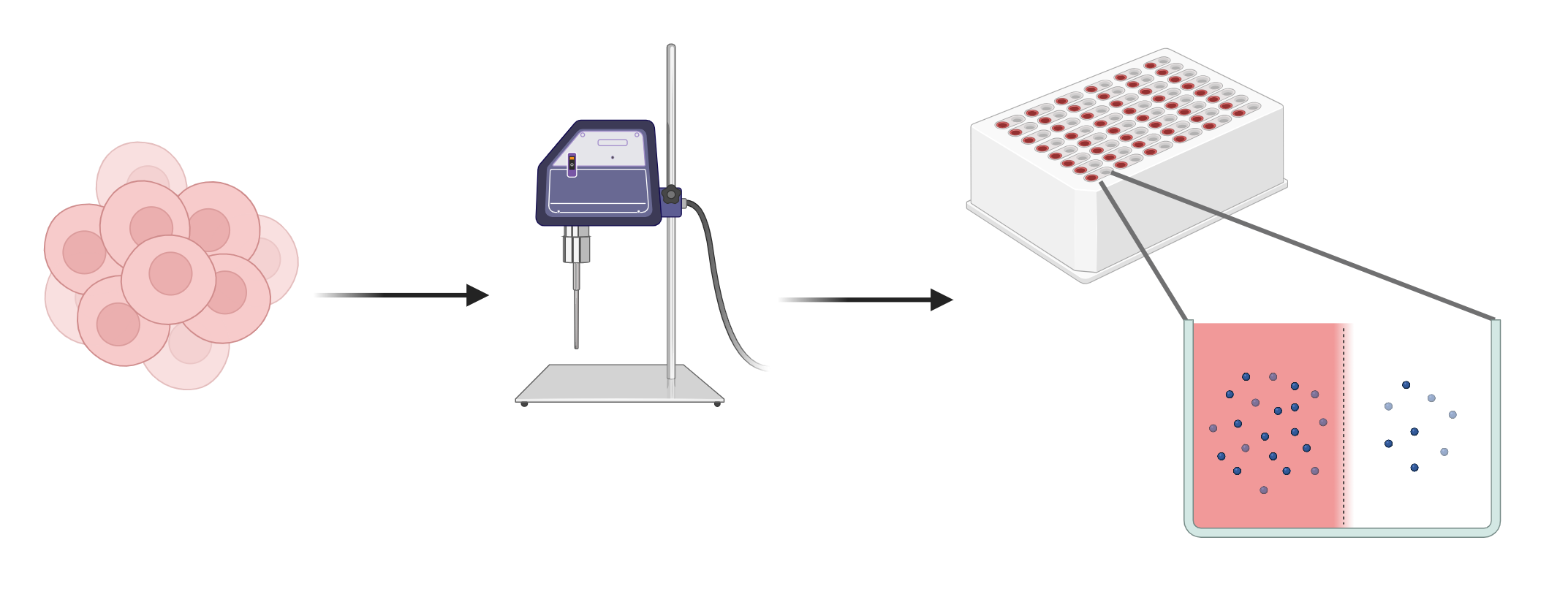
Measuring fraction unbound in cell homogenate
Methods

Slide 15
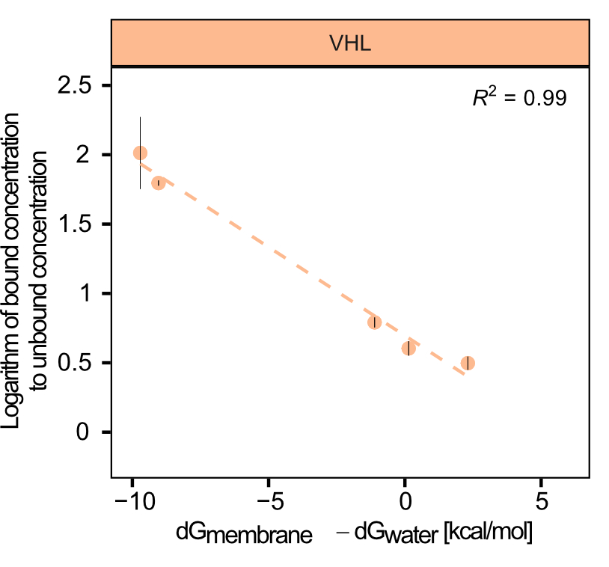
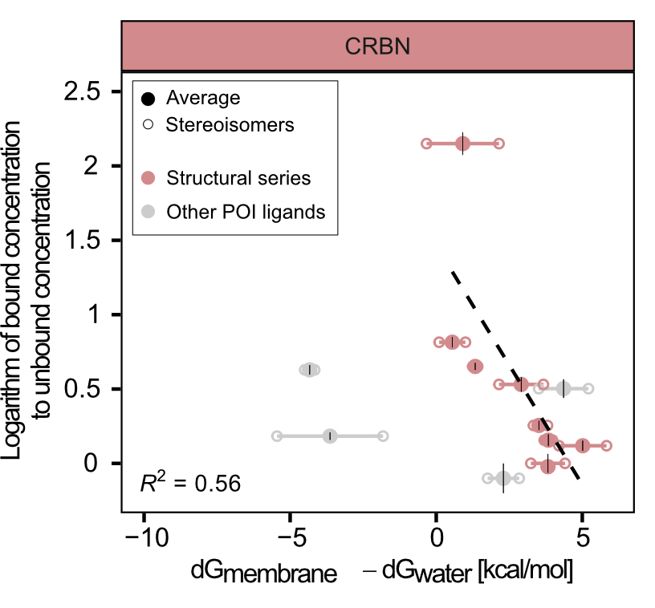
Simulated membrane interactions translate experimentally
Results
Calculated membrane energies may predict membrane affinity
Does favourable membrane interaction translate into membrane permeation?
Free energy at membrane core [kcal/mol]
Free energy at membrane core [kcal/mol]
Strong correlation for VHL-based PROTACs
Good correlation in CRBN structural series
  Same POI
  Similar E3 ligase ligand
  Variations in linker
Inganäs, E. et al (2025). J Med Chem.

Slide 16
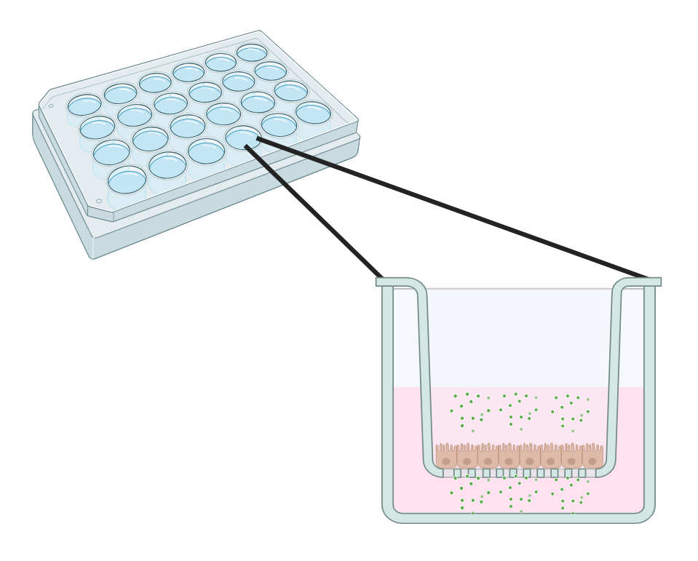
Roadmap
Roadmap
Do membrane interactions translate into membrane crossing?
Target affinity
Membrane interactions
Passive permeability
Intracellular exposure
Target engagement
Papp
What determines cellular target engagement?
Notes:
Do membrane interactions translate into membrane crossing?

Slide 17
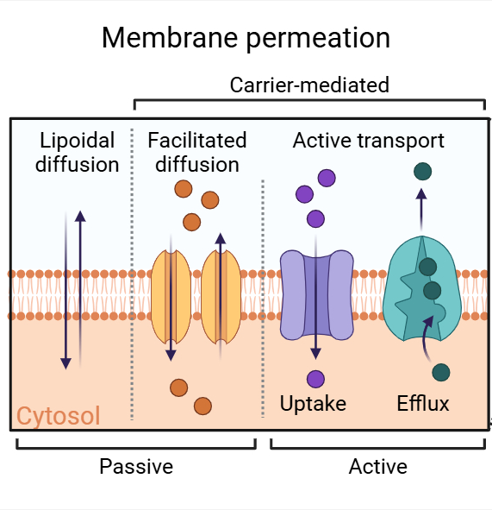
Permeability
Background
The Caco-2 assay measures permeation across a monolayer of epithelial cells

Slide 18
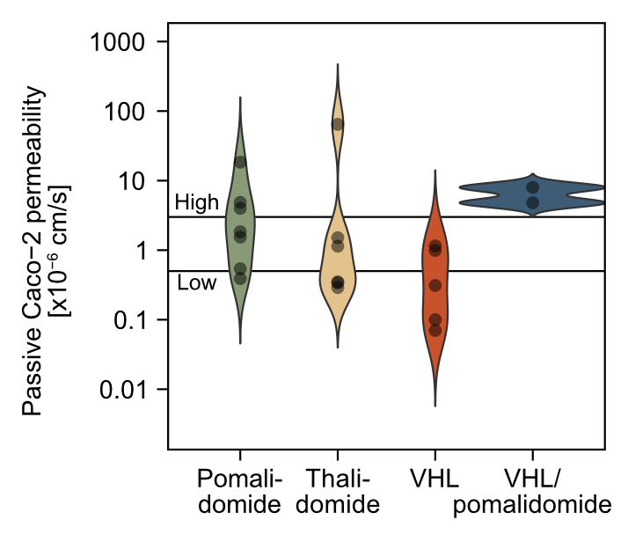
Most tested PROTACs passively permeate over membranes
Results
VHL-based PROTACs in general showed lower permeability than cereblon-based
The most lipophilic PROTACs showed very low permeability
Can membrane energetics predict passive permeability?
Inganäs, E. et al (2026). J Med Chem.

Slide 19
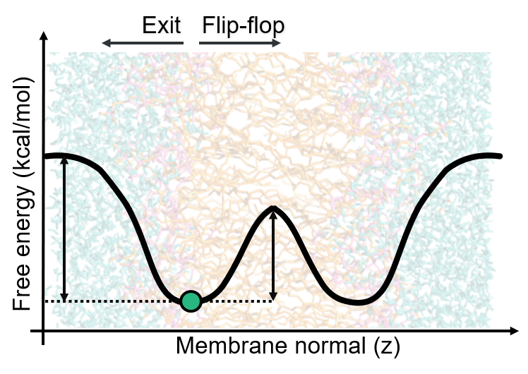
Passive permeability model
Entry → flip-flop across lipid core→ exit
Background

Slide 20
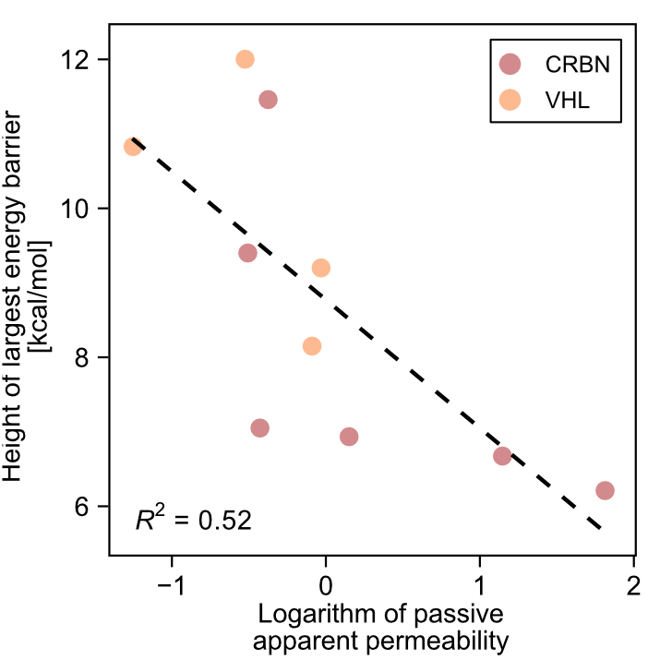
Membrane energetics are linked to passive permeability
Results
High free energy barrier ↔
low passive permeability
Highest barrier = rate limiting step?
Does passive permeability predict intracellular unbound exposure?
Inganäs, E. et al (2025). J Med Chem.

Slide 21
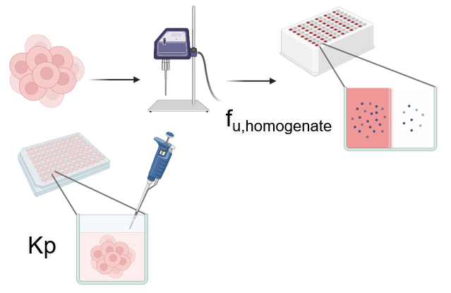
Roadmap
Roadmap
Does passive permeability determine intracellular exposure?
Target affinity
Membrane interactions
Passive permeability
Intracellular exposure
Target engagement
Kp_{uu}
What determines cellular target engagement?
Notes:
Does passive permeability determine intracellular exposure?

Slide 22
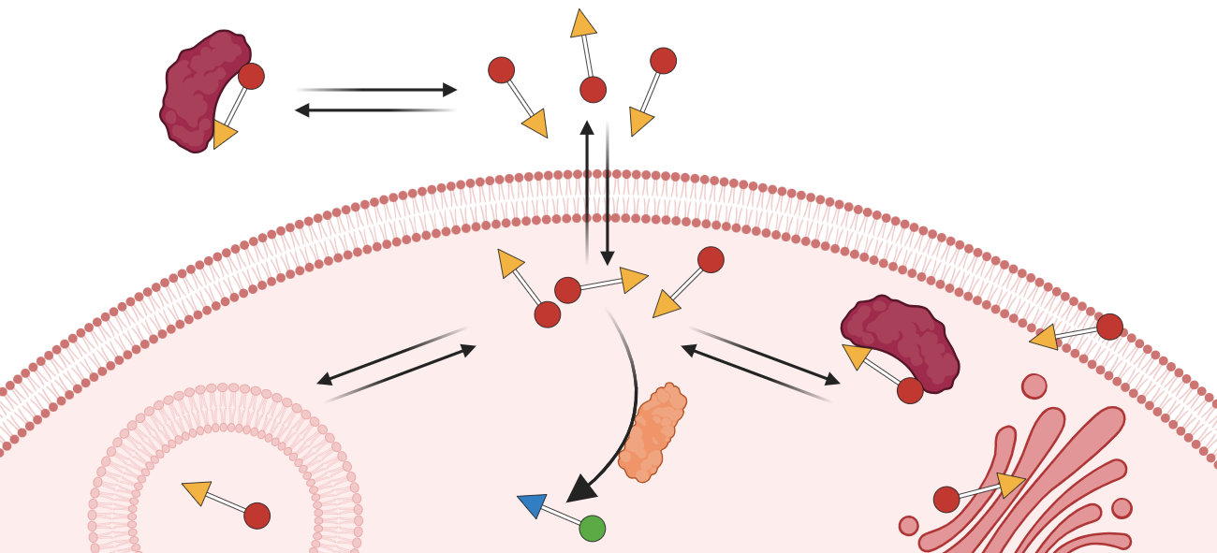
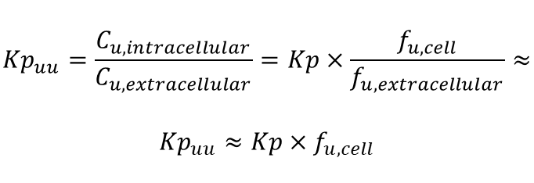
Intracellular exposure
Background
$${Kp}_{uu}=\frac{C_{u,intracellular}}{C_{u,extracellular}}=Kp×\frac{f_{u,cell}}{f_{u,extracellular}}≈$$
$${Kp}_{uu}≈Kp×f_{u,cell}$$
Total cellular exposure ratio (Kp)
Fraction unbound in the cell (f_{u,cell})
Intracellular unbound exposure ratio (Kp_{uu})

Slide 23
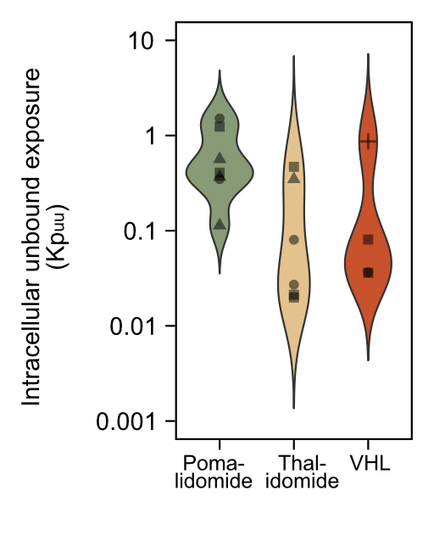
Pomalidomide-based PROTACs show the highest Kp_{uu}
Results
Inganäs, E. et al (2026). J Med Chem.
Notes:
Lägg in bild på Kpuu och permeabilitet

Slide 24
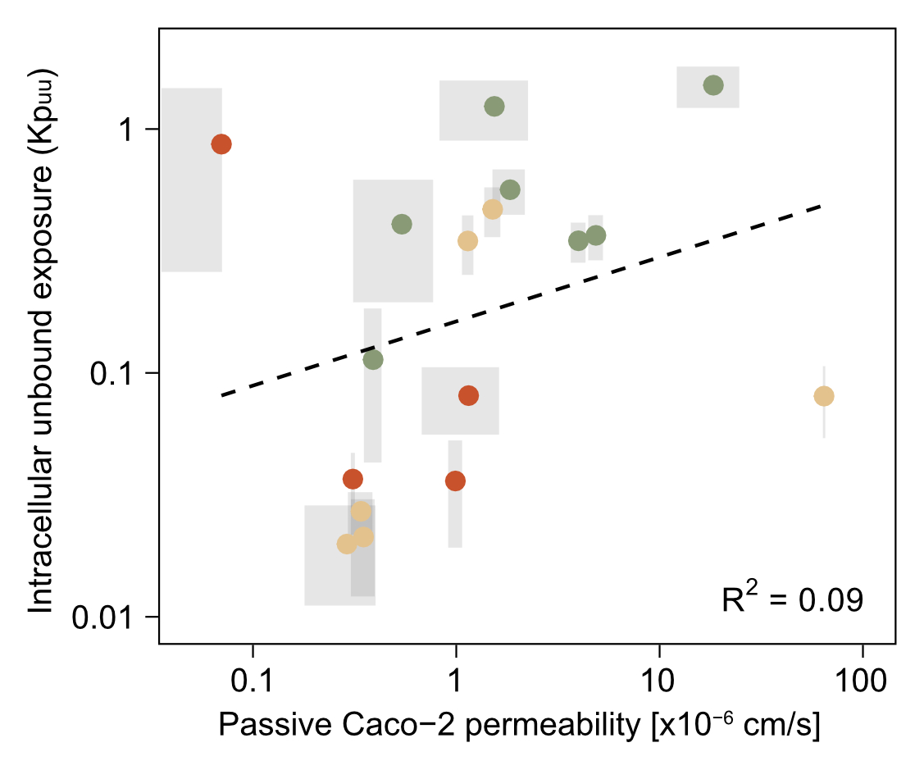
Passive permeability translates poorly into intracellular unbound exposure
Results
Inganäs, E. et al (2026). J Med Chem.
Notes:
Lägg in bild på Kpuu och permeabilitet

Slide 25
Passive permeability translates poorly into intracellular unbound exposure
Results
Which of Kp_{uu} and passive permeability better explains target engagement?
Inganäs, E. et al (2026). J Med Chem.
Notes:
Lägg in bild på Kpuu och permeabilitet

Slide 26
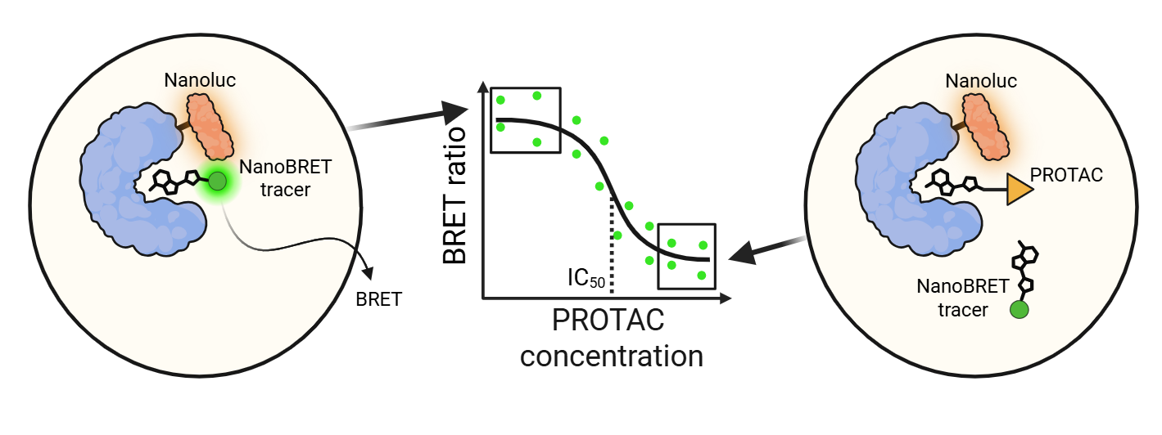
Roadmap
Roadmap
NanoBRET IC₅₀
permeabilized cells
Target affinity
Membrane interactions
Passive permeability
Intracellular exposure
Target engagement
Kp_{uu}
NanoBRET IC₅₀
live cells
What determines cellular target engagement?
Notes:
Can intracellular exposure explain target engagement—and can we disentangle exposure from affinity?

Slide 27
NanoBRET target engagement
Background
NanoBRET target engagement assay (E3 ligase)
  Competition binding assay (PROTAC vs fluorescent tracer)
  Dose-response → IC₅₀ values

Slide 28
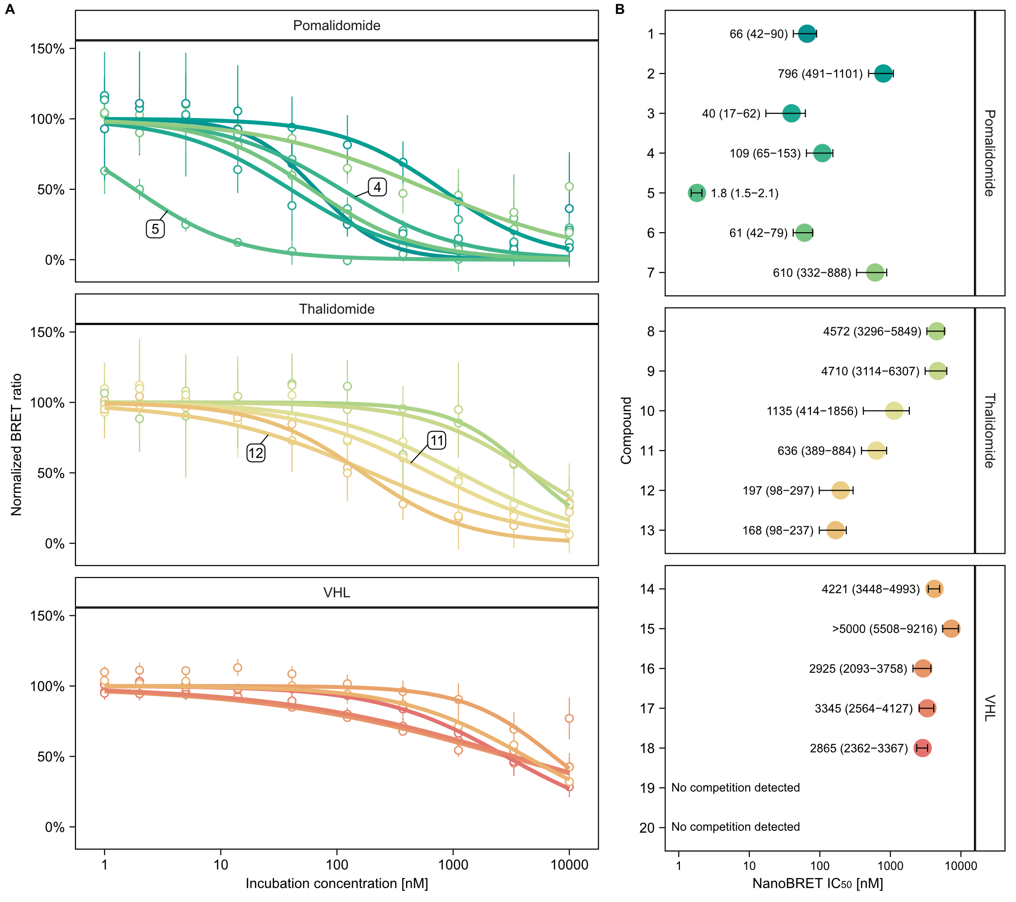
Pomalidomide-based PROTACs show strongest target engagement in general
Results
VHL-based PROTACs were the weakest competitors overall
Inganäs, E. et al (2026). J Med Chem.

Slide 29
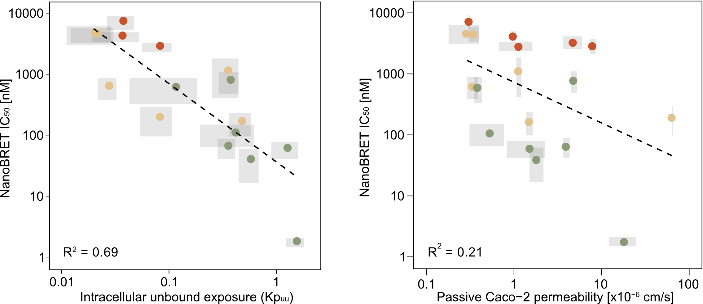
Intracellular exposure predicts cellular target engagement
Results
Inganäs, E. et al (2026). J Med Chem.

Slide 30
Intracellular exposure predicts cellular target engagement
Results
Cellular target engagement reflects at least
  How much compound that reaches the target
  How strongly it interacts with the target
If we correct cellular potency for intracellular exposure, can we recover intrinsic binding affinity?

Slide 31
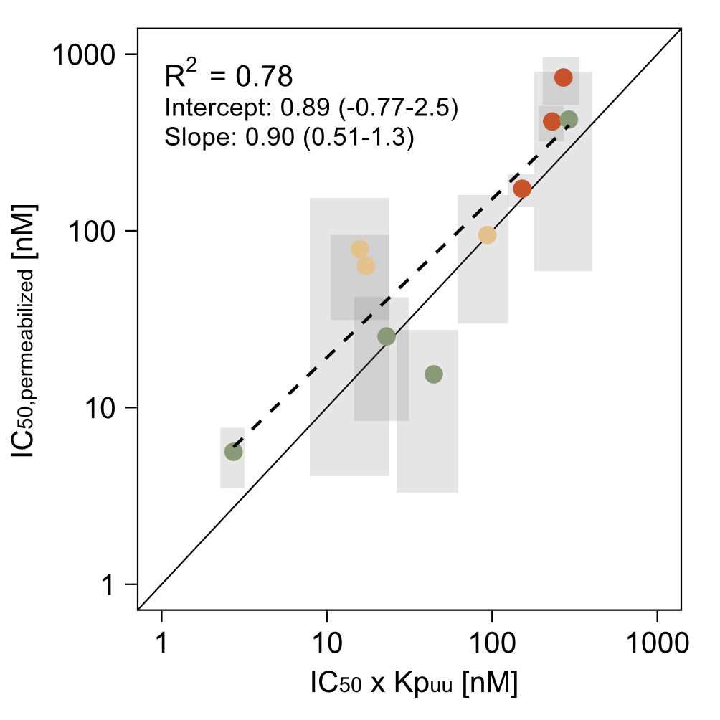
Correcting for intracellular exposure reveals intrinsic affinity
Results
Strong correlation across methods
Supports both approaches to estimate the chemical affinity at the target
Can intracellular exposure measurements help us distinguish exposure-driven SAR from affinity-driven SAR?
Inganäs, E. et al (2026). J Med Chem.

Slide 32
Exposure correction separates exposure- from affinity-driven SAR
Results
Alkyl vs PEG: Alkyl still shows stronger interaction
60-fold
difference!
16-fold
difference!
PROTAC | Linker | IC₅₀ [nM] | IC₅₀ x Kp_{uu} [nM]
dBRD9 | PEG | 109 (65-153) | 44 (26-62)
dBRD9-A | Alkyl | 1.8 (1.5-2.1) | 2.7 (2.3-3.2)
Inganäs, E. et al (2026). J Med Chem.

Slide 33
Exposure correction separates exposure- from affinity-driven SAR
Results
Alkyl vs PEG: Alkyl still shows stronger interaction
Long vs short alkyl: No difference after correction
PROTAC | Linker | IC₅₀ [nM] | IC₅₀ x Kp_{uu} [nM]
dBRD9 | PEG | 109 (65-153) | 44 (26-62)
dBRD9-A | Alkyl | 1.8 (1.5-2.1) | 2.7 (2.3-3.2)
dBET1 | Short alkyl | 636 (389-884) | 17 (11-24)
dBET6 | Long alkyl | 197 (98-297) | 16 (7.9-24)
Inganäs, E. et al (2026). J Med Chem.

Slide 34
Exposure correction separates exposure- from affinity-driven SAR
Results
Alkyl vs PEG: Alkyl still shows stronger interaction
Long vs short alkyl: No difference after correction
Linker chemistry may affect both Kp_{uu} and intrinsic E3 ligase affinity!
PROTAC | Linker | IC₅₀ [nM] | IC₅₀ x Kp_{uu} [nM]
dBRD9 | PEG | 109 (65-153) | 44 (26-62)
dBRD9-A | Alkyl | 1.8 (1.5-2.1) | 2.7 (2.3-3.2)
dBET1 | Short alkyl | 636 (389-884) | 17 (11-24)
dBET6 | Long alkyl | 197 (98-297) | 16 (7.9-24)
Inganäs, E. et al (2026). J Med Chem.

Slide 35
Take home messages
Conclusions
PROTAC membrane interactions are influenced by physicochemical properties and molecular design
Passive permeability contributes to but is not synonymous with intracellular unbound exposure
Accounting for intracellular exposure can help distinguish exposure-driven effects from intrinsic target affinity

Slide 36
Acknowledgement
Supervisors
Pär Matsson
Constanze Hilgendorf
Anders Björkbom
Collaborators and co-authors
Linda Andersson
Bomi Jung
Rémi Caraballo
Fredrik Klingegård
Hanna Lavén
MyLan Truong Eklund
Funding
Swedish Research Council
Thank you for your attention!

